Slide 1
An Agile Approach for Implementing Enterprise Software
Kevin Mann
November 2015

Slide 2
A Look Back…
Before…
Longer lead times for delivering business value.
Now…
Software releases deliver new business value every 1 to 2 months.

Slide 3
A Look Back…
Before…
A significant proportion of features were rarely or never used.
Now…
New features are highly anticipated by users and quickly adopted.

Slide 4
A Look Back…
Before…
Releases were followed by large backlogs of change requests.
Now…
Releases deliver the expected results without surprises.

Slide 5
A Look Back…
Before…
The project team was “locked-in” on specific program objectives.
Now…
The team reacts quickly to unplanned changes in business priority.

Slide 6
Our Agile Story…

Slide 7
1
5
SEAGATE OVERVIEW
SCRUM DECISION
2
6
DATA STORAGE INDUSTRY
WHAT IS SCRUM?
3
7
CASE STUDY
SCRUM RESULTS (now…)
4
INITIAL RESULTS (before…)

Slide 8
Seagate Overview

Slide 9
Seagate Overview
Seagate is a leading provider of storage devices, systems and services
FY2015 Results:
$13.7 billion in revenue
228 exabytes of storage shipped (13% Y/Y growth)
Provides storage for enterprise, desktop, mobile computing, consumer electronics and retail markets
Builds hard disk, solid state hybrid and solid state drives
41% overall market share
Approximately 52,500 employees worldwide
Source: my.seagate.com
Notes:
First quarter in history average > 1TB / unit shipped
1 exabyte = 1 Million TB

Slide 10
Seagate Brands
HDD / FLASH
BRANDED
SILICON
SYSTEMS
HYBRID SOLUTIONS
10
Notes:
Seagate: HDD & Flash storage
Lacie: Premium Branded/Retail Solutions
LSI: Flash Memory and Controllers
Dot Hill & Xyratex: Storage Systems
Evault: Data Recovery, Backup and Cloud Storage for medium sized businesses

Slide 11
Storage Industry Snapshot Market Share & Size Information

Slide 12
Total HDD Market Share
41% of the world’s digital information is stored on Seagate products
 | CY14 | Y/Y Growth
SSD Units | 70M | 39%
HDD Units | 564M | 2%
Exabytes* | 528 | 16%
110.3M Units
*1 exabyte = 1 million terabytes
STX
TOSH
WDC
Source: Seagate Strategic Marketing and Research 2015

Slide 13
The Digital Universe
The measure of all digital data created, replicated and consumed in a single year
=
44 Zettabytes
in 2020
CAGR = 42%
40
30
Zettabytes
20
10
1 thousand exabytes
1 million petabytes
1 billion terabytes
1 zettabyte =
Sources: Reinsel, David. “Where in the World Is Storage: A Look at Byte Density Across the Globe” IDC October 2013, IDC/EMC Digital Universe, April 2014 + Seagate Estimates

Slide 14
Digital Universe Driven by Emerging Markets
Share of the bitstreams in 2020 will double to 60%
China alone will account for 20%
Zettabytes
IDC Digital Universe Study, sponsored by EMC, December 2012 *United States, Western Europe, Japan, Australia, New Zealand

Slide 15
Location of Data
Location of Exabytes Shipped
400 Exabytes
In 2010, 62% of the storage was shipped into the client market…
Source: Seagate Strategic Marketing and Research 2014

Slide 16
Location of Data
Location of Exabytes Shipped
…By 2020, that will dramatically shift to the cloud
44 Zettabytes
Source: Seagate Strategic Marketing and Research 2014

Slide 17
Digital Universe: 2020
44ZB Amount of data will be created, replicated and consumed
56% in the cloud
13ZB Amount of data that will need to be stored
6.5ZB Amount of data that installed capacity will be able to hold
Demand EXCEEDS all providers – COMBINED
Sources: Reinsel, David. “Where in the World Is Storage: A Look at Byte Density Across the Globe” IDC October 2013, IDC/EMC Digital Universe, April 2014 + Seagate Estimates
Notes:
Notes for presenter:
Demand EXCEEDS capacity of all HDD & SSD providers - COMBINED

Slide 18
Case Study

Slide 19
Case Study: Enterprise Pricing Software
Target Users: Pricing, Sales & Finance
Price Management
Distributor and Retail Price Lists
Deal Management
Price Agreements
Rebate Agreements
Ship and Debit Agreements
Notes:
Approx 200 users.
PM – 3k unique weekly price points
DM – 200 PAs, 100 RAs / qtr
DM – 5k to 10k DSPAs / wk
Hundreds of Thousands of unique SKUs
10k active invoice price points

Slide 20
Case Study: Enterprise Pricing Software
On-premise Pricing software with hosted CRM front-end
Order Management
On-Invoice Prices & Discounts
Requests for Special Prices & Discounts
Customer Relationship Management
Pricing Software
Rebate Management
Off-Invoice Prices & Discounts
Approval Feedback
Enterprise Data Warehouse
All Prices & Discounts

Slide 21
Waterfall

Slide 22
Waterfall Project Plan
Requirements
Design
Develop
Unit Test
QA Test
User Acceptance Test
Deploy

Slide 23
Release Timeline
3 major releases over 2+ years
Phase 1
Phase 2
Phase 3
8 Months
13 Months
Other “High-Priority” Corporate Initiative
9 Months
17 Months
= Planned Release
Notes:
3 Major planned releases over 2+ years
-Delayed biz benefit
-4 to 18 months between planned releases
-Unused features – Overly complex UI
-Change requests
-Limited flexibility of priorities
-Could not address CR backlog after phase 3.

Slide 24
Release Results
Unused features is a common problem
Source: Standish Group, CHAOS Report 2006
Notes:
64% Never or Rarely used.
-Placeholders – “Include everything now” “Just in case”

Slide 25
Decision Point: Waterfall or Agile?
New Program Objective: Deliver highest Business priority change requests and defect fixes
Option 1: 3-phased waterfall program with fixed scope.
Option 2: Agile Scrum program with flexible scope.
Phase 1: 8 Months
Phase 2: 10 Months
Phase 3: 9 Months
8 Month Delay for any Business Value!
Approx. 2 Releases per Quarter
Notes:
About 2 years total either way
Option 1 = 8 MONTHS to biz value! : (

Slide 26
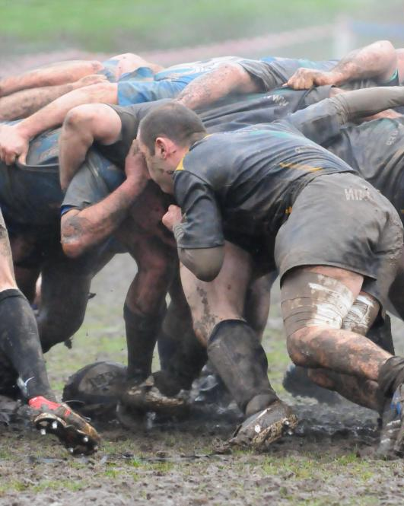
Scrum

Slide 27
What is Scrum?
Scrum in 100 words
Scrum is an agile process that allows us to focus on delivering the highest business value in the shortest time.
It allows us to rapidly and repeatedly inspect actual working software (every two weeks to one month).
The business sets the priorities. Teams self-organize to determine the best way to deliver the highest priority features.
Every two weeks to a month anyone can see real working software and decide to release it as is or continue to enhance it for another sprint.
…With Thanks to Mountain Goat Software, LLC

Slide 28
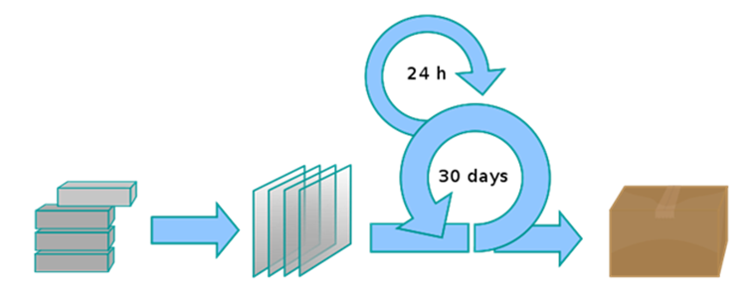
What is Scrum?
24 hrs
2-4 wks
Product Backlog
Sprint Backlog
Sprint
Tested, Working Increment of Software
Notes:
10 minute Daily Scrum.
10 to 60 minute Daily Review (defect disposition, demos, requirements clarification
Easier to fix code if feedback < 24 hrs.
Quality Center
Defects may feed into Product Backlog.
Definition of “done”

Slide 29
What is Scrum?
Waterfall Project
Features
The planned features (scope) first are defined in detail, driving the cost / schedule estimates.
Plan Driven
Estimates
Cost
Schedule

Slide 30
What is Scrum?
Agile Project
Constraints
Cost
Schedule
Value / Vision Driven
Cost and schedule are fixed, and the team works to implement the highest value features as defined by the customer, so that scope remains flexible.
Estimates
Features

Slide 31
What is Scrum?
Waterfall
Agile
The plan creates cost / schedule estimates.
The vision creates feature estimates.
Constraints
Features
Cost
Schedule
Value / Vision Driven
Plan Driven
Cost
Features
Estimates
Schedule
Notes:
How many features can be delivered in a time-boxed release cycle?
Forced to deliver the most important features.

Slide 32
Selling Agile to Executive Stakeholders
Education
Benefits
Trade-offs
Good Fit
Notes:
Rally Training
Time to value
Unused or missed features
Flexibility
Engaged Product Owner (in addition to “Day Job”)
Pricing Systems intersect with many Business Processes

Slide 33
Scrum Team
Role | Count | Primary Responsibilities
Contracted Solution Architect & Developer | 2 | Design Development Guide Internal Developers
Developer | 2 | Design Development
Quality Assurance | 2 | Develop Test Plans Execute QA Tests
Business Analyst | 1 | Develop Requirements Reduce Overhead for Product Owner
Product Owner | 1 | Define “User Stories” (aka Backlog Items) Prioritize Product Backlog Define Acceptance Criteria Control Points: Requirements Sign-off Test Plan Sign-off UAT Sign-off
Scrum Master | 1 | Facilitate Scrum Process Coordinate with Cross Functional Teams

Slide 34
Point Estimating
The team estimates “points” for each backlog item
Points | Definition
1 | “extra-small”
2 | “small”
3 | “medium”
5 | “large”
8 | “extra-large”
Notes:
The larger something is, the more difficult it is to distinguish incremental amounts of complexity.
If bigger than 8, break-down into smaller items.

Slide 35
Sprint Velocity
Averaging 15 story points per 2-week sprint
Notes:
Velocity Allows confident Release Planning

Slide 36
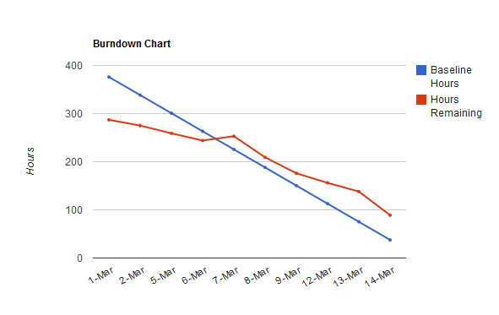
Sprint Burn Down

Slide 37
Results

Slide 38
Releases & Business Reaction
6 releases in the first 7 months
= Release
Aug Sept Oct Nov Dec Jan Feb
Defect fixes from prior project
Usability improvements targeting Sales and Pricing users
Changes to support Samsung HDD integration
Notes:
Deal Line Item Import & Mass-Edit
Shortcuts for creating Line Item Revisions
Deal Expire
Rebate Agreement UI Improvements
Improvements to Publication Document
Improved Email Alert Content
Improved Deal Cycle Time Report Content
Data Input Validations
Price Manager & SFDC Integration Defect Fixes
!!Able to shift priorities in-stride!

Slide 39
Agile Results vs. Waterfall
Agile: 6 Releases
= Release
Aug Sept Oct Nov Dec Jan Feb
Waterfall: 0 Releases
Aug Sept Oct Nov Dec Jan Feb
Notes:
First planned release still over 2 months away! ☹
Still in QA, UAT not started. : (
Samsung shift in priorities would have halted all progress. : (

Slide 40
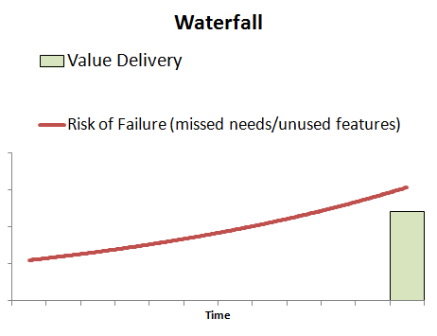
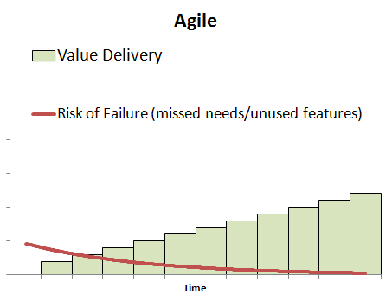
Results
Increased Flexibility
Reduced Time to Value
Reduced Risk of Failure
Notes:
Fewer defects and change requests.
Scrum is working for us, consider it!!

Slide 41
Q & A

